Slide 1

Build intelligent apps with WinUI, Phi Silica and the Windows Copilot Runtime
Alvin Ashcraft
Sr. Content Developer - Microsoft

Slide 2
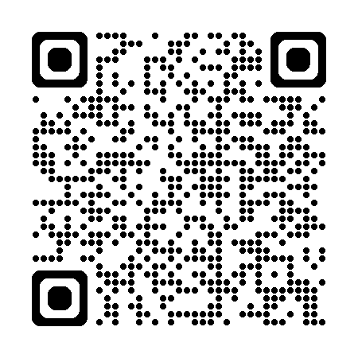
About Me
Software industry for nearly 30 years
Morning Dew link blog
Three books for Packt Publishing
Content developer at Microsoft since 2022
TechBash dev conference organizer since 2016
Slides & demos:
Notes:
A little background about me…
For those who don’t know me, I’ve been in the software industry since 1995, with most of that time (over 25) years spent as a developer and architect using various Microsoft technologies.
Some of you may also be familiar with my blog, the Morning Dew, where I’ve been posting daily links for .NET developers since 2007.
I also have three books from Packt Publishing. You can check those out on Packt’s website or on Amazon. Just search for my name.
Writing those books led me to pivot my career to technical writing. I joined Microsoft two years ago as a content developer. I write documentation, training modules, and code samples on Microsoft Learn. I work on the Windows developer docs team, helping to maintain the docs for client apps and APIs. I have another talk I give about my work as a content developer and how anyone can contribute to content on Learn through GitHub issues and PRs.
Finally, I’m one of the founding organizers of the TechBash developer conference. We’ve been running the event in the Poconos since 2016.

Slide 3

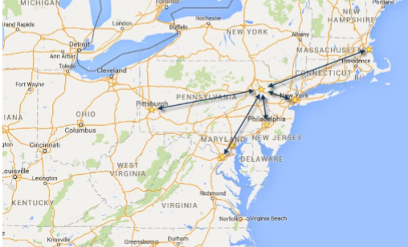
November 4-7, 2025 | Pocono Manor, PA
Great speakers with top content
A fraction of the cost of many large conferences
- 3-day event plus lodging for less than $1300 (Early Bird)
Workshops announced: Jeremy Clark, Chad Green & more
Kubernetes, DI in C#, AI, Messaging Patterns & PostgreSQL
World-class keynotes
Kevin Griffin – State of .NET Foundation & .NET Open-Source
Nicole Tibaldi – Prioritizing the health of your engineering team
In addition to the sessions, you get great networking, amazing food, attendee Welcome Reception, Game Night & more
Family Day Friday - full day of kids' sessions, free for attendees' families
Discounted Kalahari Resort rooms with water park access: stay, learn & play all week
https://techbash.com or @techbash

Slide 4
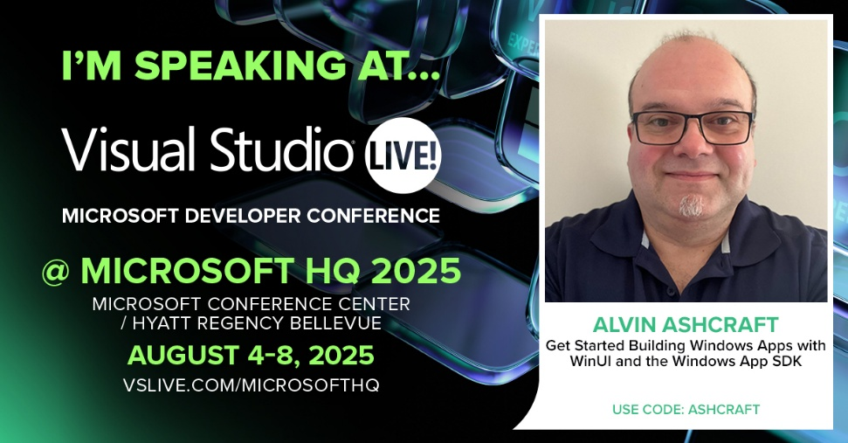
Join Me at VSLive! @ MicrosoftHQ
Use code “Ashcraft” to save $400 on 4-day or 5-day packages
Aug 4-8 at Redmond Campus
https://vslive.com/microsofthq

Slide 5

Agenda
AI Options for .NET Developers
WinUI and Windows App SDK
Copilot+ PCs and Phi Silica
The Phil Silica APIs in Windows App SDK
Text Recognition APIs
Recall in Windows – Where does my app tie in?
The AI Dev Gallery app for Windows
Q&A

Slide 6

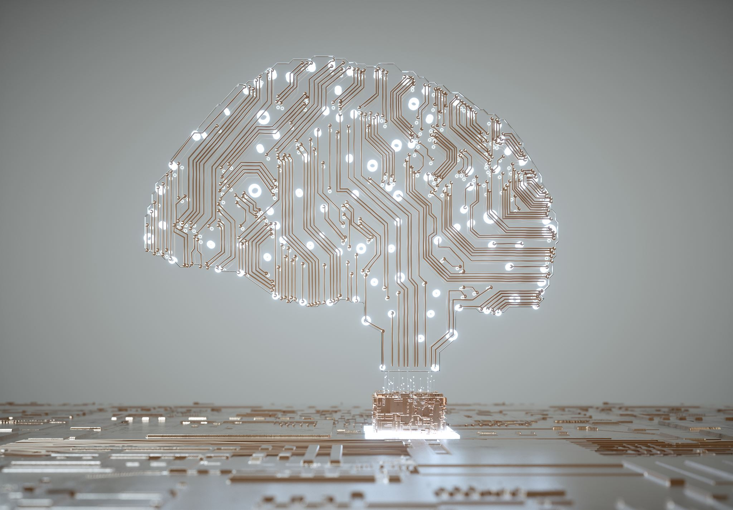



Exploring AI for .NET Developers
Microsoft.Extensions.AI libraries for .NET.
Semantic Kernel – Build agents and consume models with C#, Python or Java.
AI Toolkit for VS Code.
GitHub Copilot in Visual Studio and VS Code.
Azure AI Foundry
Windows Copilot Runtime
Notes:
In this section, we'll explore various AI options that are specifically designed for .NET developers. This includes tools, frameworks, and best practices that can streamline the integration of AI into your existing applications.

Slide 7

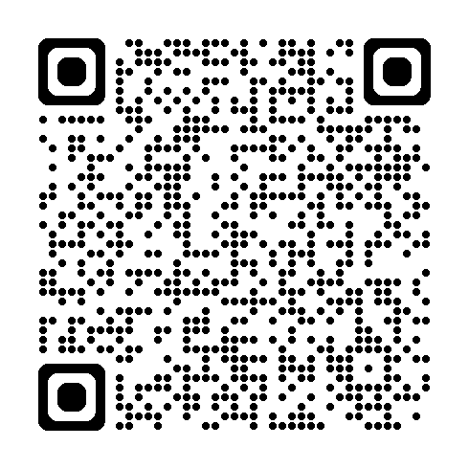
WinUI and Windows App SDK
Understand the benefits of WinUI for modern applications.
Learn how Windows App SDK enhances app development.
Access .NET 9, WinRT APIs, and Windows App SDK APIs in WinUI apps.
Get started on Microsoft Learn:
Notes:
This slide will cover the advantages of using WinUI in your application development. We will also discuss how the Windows App SDK can enhance the overall development experience and what features are available when using both together.

Slide 8
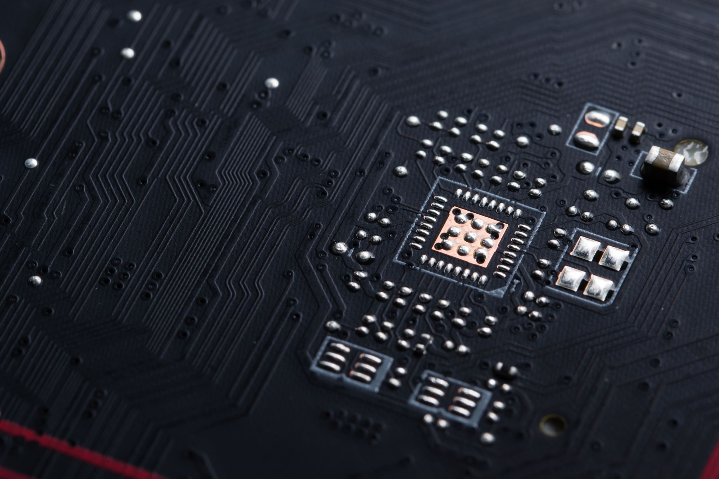
Copilot+ PCs and Phi Silica
Introducing Copilot+ PCs and their integration with Windows development tools.
What’s the role of Phi Silica on Windows Copilot+ PCs?
NPU-tuned local model
Practical applications of the Windows Copilot Runtime and benefits for developers:
Local model
OCR
Imaging
Content moderation
Notes:
Here, we will provide an overview of Copilot+ PCs and their significance in development environments. Additionally, we will explore how Phi Silica contributes to performance improvements and what that means for developers.

Slide 9

Phil Silica APIs in Windows App SDK
Overview of the Phil Silica APIs.
Utilize these APIs in your Windows apps: WinUI, WPF and Windows Forms!
Demo time:
WinUI app
Query local model
Stream response or wait
Moderation filters
Notes:
In this section, we will delve into the Phil Silica APIs available through the Windows App SDK. We will cover how to effectively use these APIs in your projects and present case studies of successful implementations.

Slide 10
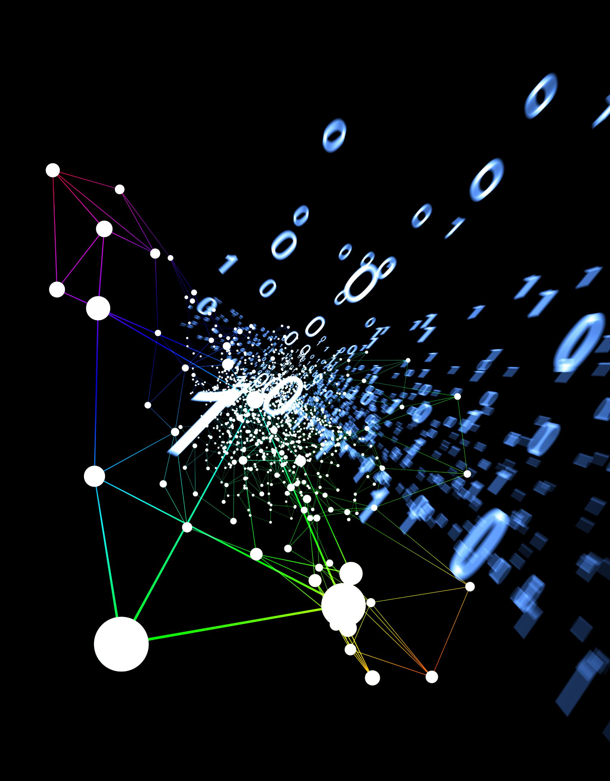
Text Recognition APIs
Explain the functionality of text recognition capabilities.
Discuss potential applications of text recognition in apps.
Demo
WPF app
Load image
OCR to product text
Use model to explain the text
Notes:
This slide will focus on text recognition APIs, their functionalities, and potential applications. We will also go over coding examples to illustrate how these APIs can be incorporated into your applications effectively.

Slide 11
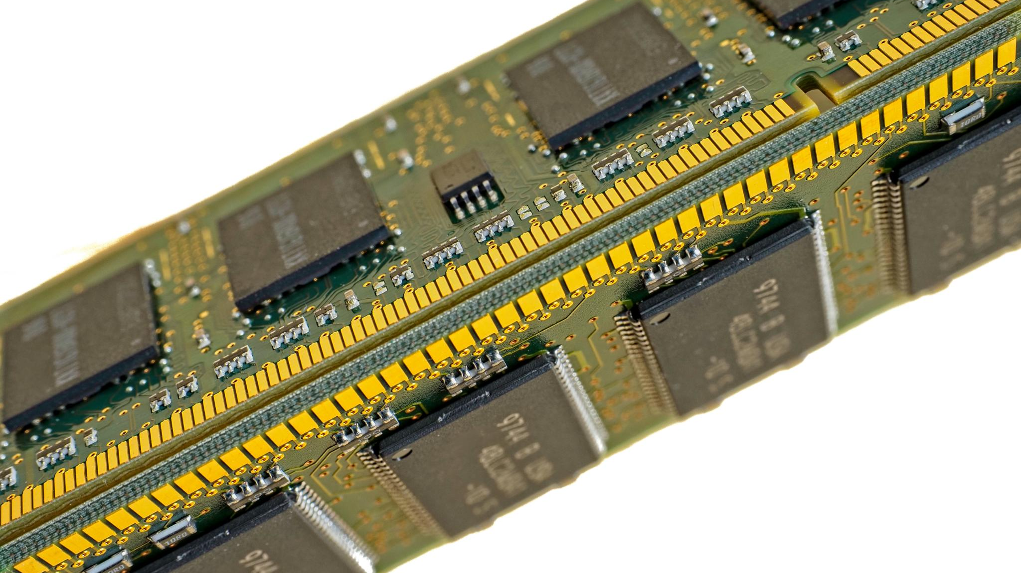
Recall in Windows & Integration with Your Apps
Windows Recall integration options in Windows apps.
Opt-in feature only available on Copilot+ PCs.
Enhance user experience in Recall:
Launch Click to Do
Search Recall for images related to your app
Use UserActivity APIs to record specific app data related to saved snapshots.
APIs still in experimental state and evolving.
Notes:
In this final section, we will explore how Recall can be integrated into Windows applications. We'll discuss memory management importance and share best practices to enhance the overall user experience in your apps.

Slide 12
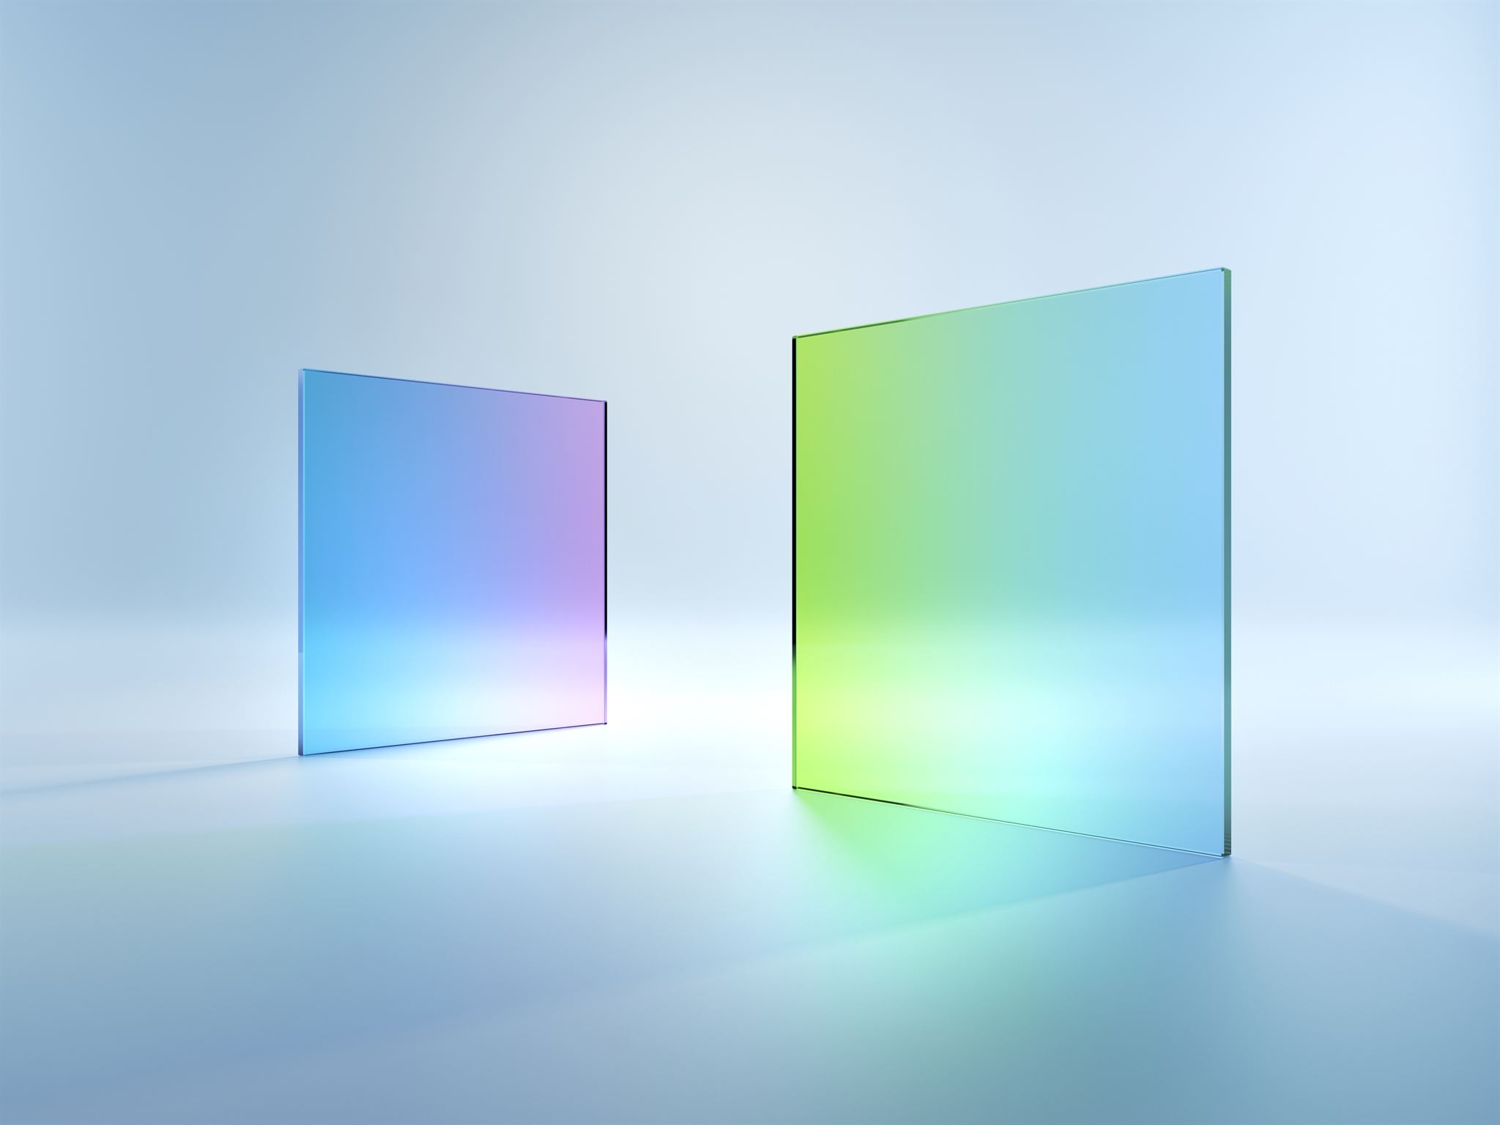
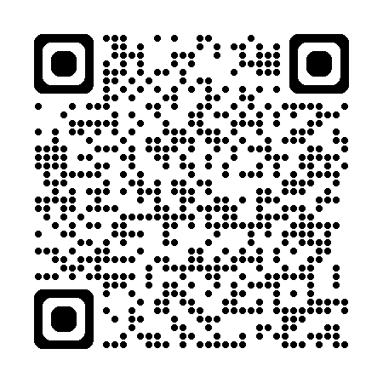
AI Dev Gallery App for Windows
AI Dev Gallery – Get it in the Microsoft Store.
Over 25 interactive local AI sample apps.
Discover and download local models.
Open source on GitHub:
Notes:
Here we'll introduce the AI Dev Gallery app for Windows, highlighting its features and available resources. We will also encourage users to provide feedback and contribute to the app's growth.

Slide 13

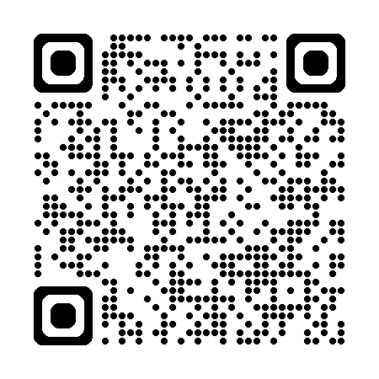
Q&A
Any questions?
Contact me: alvin@alvinashcraft.com
Learn more in the Windows AI docs on Microsoft Learn:
Notes:
In the Q&A session, we will open the floor for questions from the audience. This is a great opportunity to discuss any topics covered during the presentation and clarify any doubts.

